Slide 1
UV IN PYTHON

Slide 2
What is UV in python?
"uv" refers to a high-performance, modern package manager and installer, written in Rust. It's designed as a drop-in replacement for traditional tools like pip and pip-tools, offering significant speed improvements and a more intuitive user experience
Key features and benefits of uv:
Speed:
uv is significantly faster than pip and other package managers, with some sources reporting it to be 10-100 times faster.
Rust-based:
Written in Rust, uv benefits from Rust's performance and safety features.
Drop-in replacement:
uv is designed to work seamlessly with existing workflows, allowing users to easily switch from traditional tools without major changes.
Comprehensive features:
uv supports various features, including editable installs, Git and URL dependencies, constraint files, custom indexes, and more.
Virtual environment management:
uv provides tools for creating and managing virtual environments, ensuring isolated and consistent project environments.
Project management:
Beyond package management, uv also offers features for project initialization, dependency resolution, and version management.
Cross-platform:
uv is cross-platform, supporting Linux, Windows, and macOS.
Disk space efficiency:
uv uses a global cache for dependency deduplication, reducing disk space usage.
In essence, uv aims to provide a more streamlined, efficient, and reliable package management experience for Python developers.

Slide 3
Difference between pip and uv
Feature | pip | uv
Implementation | Python | Rust
Performance | Slower, especially with large projects | Significantly faster, 10-100x in some cases
Dependencies | Relies on external tools and libraries (e.g., setuptools, wheel) | Minimal dependencies, mostly a single binary
Download | Processes downloads sequentially | Downloads packages in parallel
Caching | Less advanced caching | More advanced caching, avoiding redundant downloads and resolving
Error Handling | Can have verbose error messages | Provides clearer and more informative error messages
Dependency Resolution | Can be slower and less effective with complex dependencies | Implements a more efficient and reliable dependency resolver
Environment Management | Often requires external tools like virtualenv | Can manage virtual environments as part of its core functionality
Configuration | Uses separate requirements.txt and potentially other config files | Employs pyproject.toml as the primary configuration file
Reproducibility | Basic requirements.txt doesn't guarantee consistent environments across systems | Lockfile approach ensures consistent environments across different systems
Functionality | Primarily a package installer | A broader project manager that can handle more than just installation
Pre-release handling | May have inconsistencies in handling pre-release identifiers in transitive dependencies | Intentionally limited and requires user opt-in for pre-release support

Slide 4
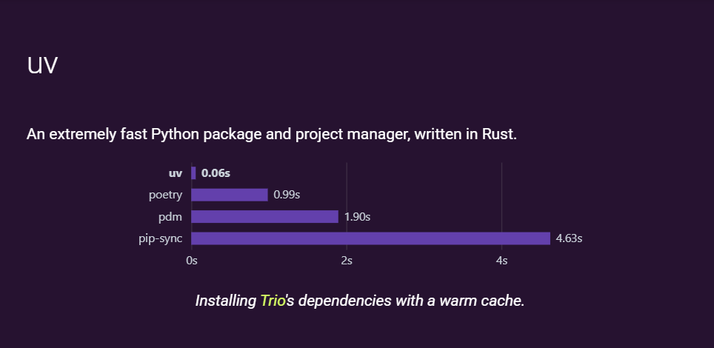

Slide 5
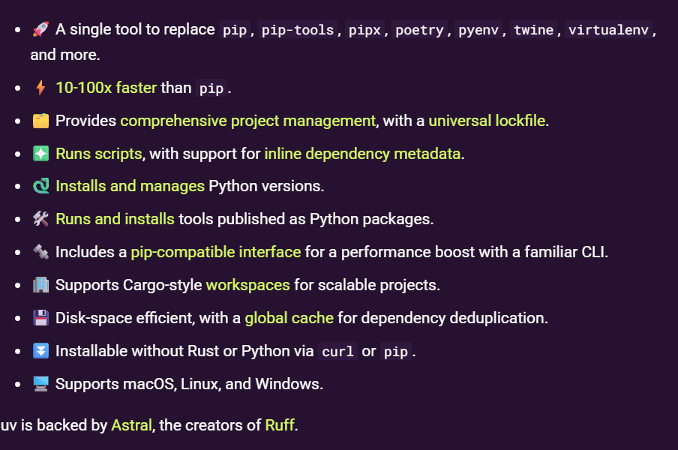

Slide 6
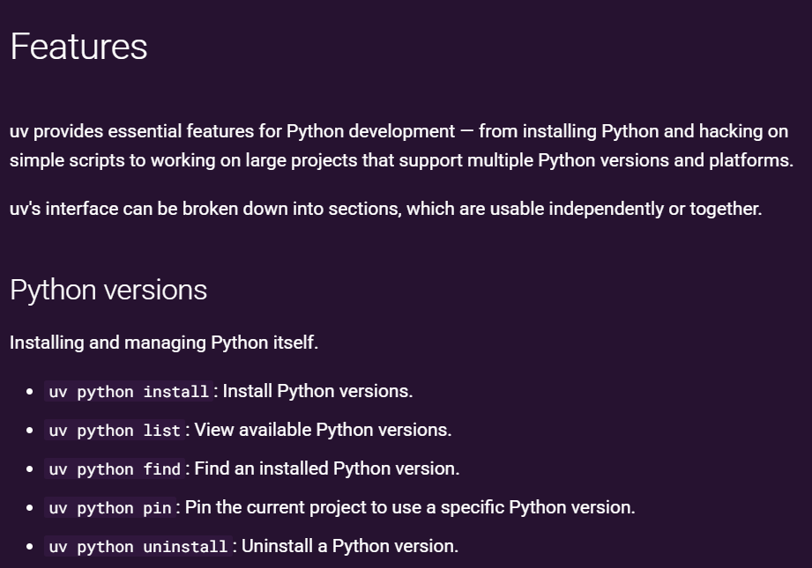

Slide 7
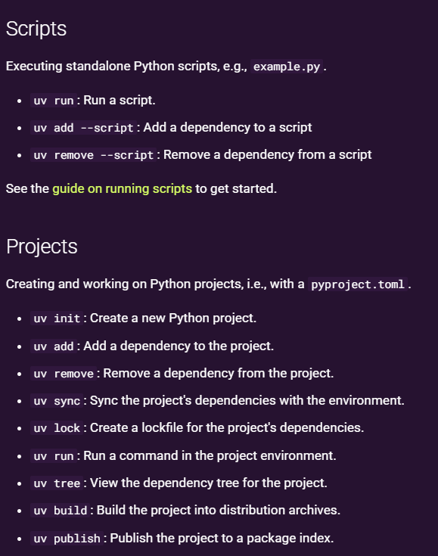

Slide 8
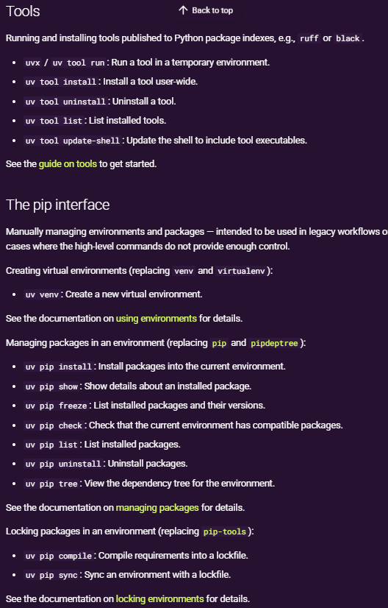

Slide 9
